Slide 1

Chapter 4: Problem Solving with Selection Control

Slide 2
Learning Outcomes
Outline
At the end of this chapter, student should be able to:
Analyse and solve programming problem (C4, CTPS)
Use problem-solving chart to develop a solution using one-way and nested selection statement (C3,CTPS)
Construct program using one-way and nested selection statement (C3)
Use one –way and nested selection statement to develop problem solution (C3)
Develop problem and construct program using the case logic structure. (C3)
Selection Structure
Boolean Data Type and Comparison Operators
If Statement and Two-Way Selection Statements
Nested and Multi-Way Selection Statements

Slide 3
Sequential Structure
From previous problems (Topic 3),
Performs a series of steps in a sequence.
The order is important to get the accurate output.
start
Instruction
Instruction
end

Slide 4
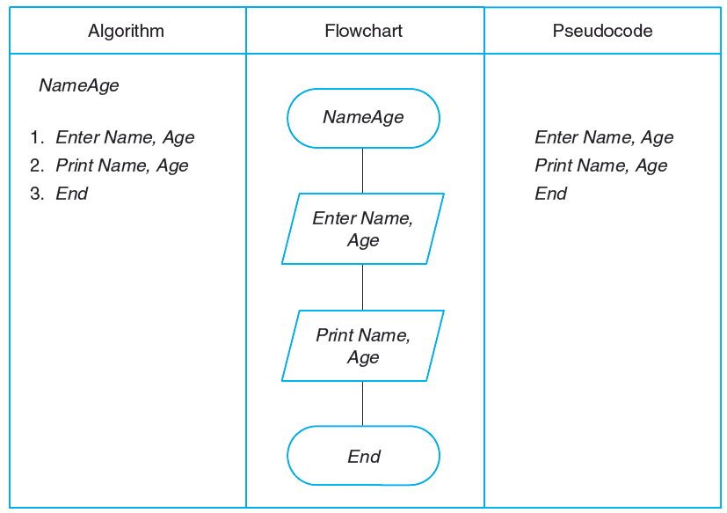
Algorithm, Flowchart, and Pseudocode to Enter and Print Two Variables

Slide 5
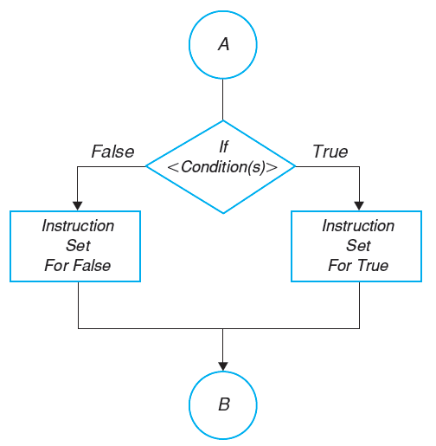
Flowchart Diagram of the Selection Structure
Selection/decision Structure
Make decision based on certain conditions

Slide 6

The boolean Type and Operators
If you need to compare two values, such as whether i is greater than j, Java provides six comparison operators (also known as relational operators) that can be used to compare two values.
The result of the comparison is a Boolean value: true or false
boolean b = (1 > 2);

Slide 7
Comparison Operators
Operator Name
< less than
<= less than or equal to
> greater than
>= greater than or equal to
== equal to
!= not equal to

Slide 8
Logical Operators
Operator Name
! not
&& and
|| or

Slide 9
Truth Table for Operator !

Slide 10
Truth Table for Operator &&

Slide 11
Truth Table for Operator ||

Slide 12
selection Statements

Slide 13

Selection Statements
Implemented using the IF/THEN/ELSE instruction.
Tells the computer that
IF a condition is true,
THEN execute a set of instructions,
or ELSE execute another set of instructions
ELSE part is optional, as there is not always a set of instructions if the conditions are false.
Format:
IF <condition(s)> THEN
<TRUE instruction(s)>
ELSE
<FALSE instruction(s)>

Slide 14
One-Way Selection Statements
Example Problem 1
Calculate the area of a circle if the radius is positive where
area = pi * radius * radius

Slide 15
Problem 1
PAC
IPO
Given Data | Required results
radius | area
Processing Required | Solution Aternatives
if (radius is positive) Calculate area Print area | pi as a constant (pi= 3.14)
Input | Processing | Module | Output
radius | Enter radius If (radius > 0) then area = radius x radius x 3.14 Print area EndIF End |  | area

Slide 16
Problem 1
Flowchart
Pseudocode
Start
Read radius
if radius > 0 then
area= radius * radius * 3.14
print area
endif
End
Start
Read radius
false
If (radius > 0)
true
area = radius * radius * 3.142
Print area
End

Slide 17
Problem 1
import java.util.Scanner;
public class Circle {
public static void main (String[] args) {
Start
Scanner scan = new Scanner (System.in);
System.out.print (“Enter radius: “);
double radius = scan.nextDouble();
Read radius
false
If (radius > 0)
if (radius > 0) {
double area = radius * radius * 3.142;
System.out.println (“Area = “ + area);
}
true
area = radius * radius * 3.142
Print area
End
}
}

Slide 18
Problem 1
START | import java.util.Scanner; public class Circle { public static void main (String[] args) { double radius = 0.0, area = 0.0; Scanner scan = new Scanner (System.in);
READ radius | System.out.print (“Enter radius: “); radius = scan.nextDouble();
IF (radius > 0) area = radius * radius * 3.14 PRINT area ENDIF | if (radius > 0) { area = radius * radius * 3.14; System.out.println (“Area = “ + area); }
END | } }

Slide 19
Problem 1 (Code segment)
if (booleanExpression) {
statement(s);
}
if (radius >= 0) {
area = radius * radius * 3.14;
System.out.println("The area“ + “ for the circle of radius “ + radius + “ is " + area);
}

Slide 20
One-Way if Statements
if (booleanExpression) {
statement(s);
}
false
Boolean
Expression
true
Statement(s)

Slide 21
One-Way if Statements
if (radius > 0) {
area = radius * radius * PI;
System.out.println ("The area“ + “ for the circle of radius “ + "radius is " + area);
}
false
(radius > 0)
true
area = radius * radius * PI;
Print area

Slide 22
Note
Braces can be omitted if the block contains a single statement
if (i > 0) {
System.out.println("i is a positive integer");
}
…is equivalent to
if (i > 0)
System.out.println("i is a positive integer");

Slide 23
One-Way if Statements
if (marks >= 40)
System.out.println(“You have passed!”);
if (marks < 40)
System.out.println(“You have failed!”);

Slide 24
Exercise: Trace the code below and display the output.
i.
int marks = 50.0;
if (marks > 40) {
System.out.println (“You have passed”);
System.out.println (“Well done”);
}
ii.
int marks = 50.0;
if (marks < 40)
System.out.println (“You have failed”);
System.out.println (“Well done”);

Slide 25
Note
Outer parentheses required
if ((i > 0) && (i < 10)) {
System.out.println("i is an integer between 0 and 10");
}

Slide 26
Two-Way Selection Statements
if (boolean-expression) {
statement(s)-for-the-true-case;
}
else {
statement(s)-for-the-false-case;
}
true
Boolean
Expression
false
Statement(s) for the true case
Statement(s) for the false case

Slide 27
Two-Way Selection Statements
Use in situation in which you must choose between two alternatives.
Problem 1
Calculate the area of a circle if the radius is positive where
area = pi * radius * radius
Otherwise display message “Radius must positive”.

Slide 28
Example
if (marks >= 40)
System.out.println(“You have passed!”);
else
System.out.println(“You have failed!”);

Slide 29
Problem 1
PAC
IPO
Given Data | Required results
radius | area
Processing Required | Solution Aternatives
if (radius is positive) Calculate area Print area Otherwise Print “Radius must positive” | pi as a constant (pi= 3.14)
Input | Processing | Module | Output
radius | Enter radius If (radius > 0) then area = radius x radius x 3.14 print area Else print ”Radius must positive” Endif |  | area or “Radius must positive”

Slide 30
Problem 1
Flowchart
Pseudocode
Start
Read radius
if radius > 0 then
area= radius * radius * 3.14
print area
else
print “Radius must positive”
endif
End
Start
Read radius
false
If (radius > 0)
Print “Radius must positive”
true
area = radius * radius * 3.142
Print area
End

Slide 31
Problem 1
import java.util.Scanner;
public class Circle {
public static void main (String[] args) {
Start
Scanner scan = new Scanner (System.in);
System.out.print (“Enter radius: ”);
double radius = scan.nextDouble();
Read radius
false
if (radius > 0) {
double area = radius * radius * 3.142;
System.out.println (“Area = “ + area);
}
If (radius > 0)
Print “Radius must positive”
true
else
System.out.println (“Error: Radius must positive”);
area = radius * radius * 3.142
Print area
}
}
End

Slide 32
Problem 1
START | import java.util.Scanner; public class Circle { public static void main (String[] args) { double radius = 0.0, area = 0.0; Scanner scan = new Scanner (System.in);
READ radius | System.out.print (“Enter radius”); radius = scan.nextDouble();
IF (radius > 0) Area = radius * radius * 3.14 PRINT area | if (radius > 0) { area = radius * radius * 3.14; System.out.println (“Area = “ + area); }
ELSE PRINT “radius must positive” ENDIF | else System.out.println (“radius must positive”);
END | } }

Slide 33
Problem 1 (Code segment)
if (radius > 0) {
area = radius * radius * 3.14159;
System.out.println("The area for the "
+ "circle of radius " + radius +
" is " + area);
}
else {
System.out.println("Negative input");
}

Slide 34
Example
if (number % 2 == 0)
System.out.println(number + “ is even”);
else
System.out.println(number + “ is odd”);

Slide 35
Example
Assume you are calculating pay at an hourly rate, and overtime pay (over 40 hours) at 1.5 times the hourly rate.
IF the hours are greater than 40, THEN the pay is calculated for overtime, or ELSE the pay is calculated in the usual way.

Slide 36
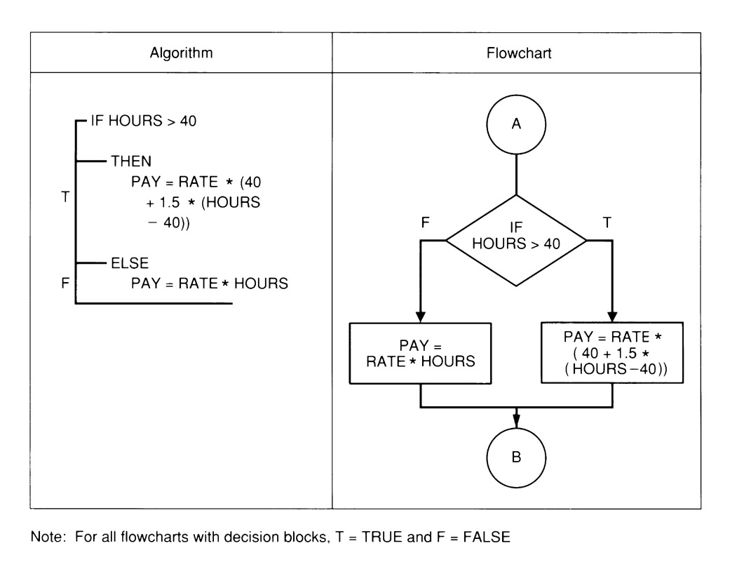
Example Decision Structure

Slide 37
import java.util.Scanner;
class PayCalculation {
public static void main(String[] args) {
double hours, payRate, pay;
Scanner scanner = new Scanner (System.in);
System.out.print (“Enter hours work: “);
hours = scanner.nextDouble();
System.out.print (Enter your pay rate: “);
payRate = scanner.nextDouble();
if (hours > 40.0)
pay = payRate * (40.0 + 1.5 * (hours – 40.0));
else
pay = payRate * hours;
System.out.println (“Hours work: “ + hours);
System.out.println (“Total Pay: “ + pay);
}
}

Slide 38
Exercise
Draw a flowchart and write a program to read an integer number and check whether it is negative or positive, and later display message “Negative” or “Positive”.

Slide 39
Caution
Adding a semicolon at the end of an if clause is a common mistake.
if (radius >= 0); {
area = radius*radius*PI;
System.out.println(
"The area for the circle of radius " +
radius + " is " + area);
}
This mistake is hard to find, because it is not a compilation error or a runtime error, it is a logic error.
This error often occurs when you use the next-line block style.
Wrong

Slide 40
Nested if/then/else Instructions
Multiple decisions.
Instructions are sets of instruction in which each level of a decision is embedded in a level before it.

Slide 41
Nested if/then/else Instructions
if (marks >= 80){
grade = ‘A’;
if (marks == 100)
System.out.println(“Full marks!”);
}
if (marks >= 80)
if (marks == 100)
System.out.println(“Full marks!”);
Braces can be omitted

Slide 42
Nested if/then/else Instructions
if (marks >= 80)
if (marks == 100)
System.out.println(“Full marks!”);
equivalent to
if ((marks >= 80) && (marks == 100))
System.out.println(“Full marks!”);

Slide 43
Multiple Alternative if Statements
This is better

Slide 44
Multi-Way if-else Statements

Slide 45
Trace if-else statement
animation
Suppose score is 70.0
The condition is false
if (score >= 90.0)
grade = 'A';
else if (score >= 80.0)
grade = 'B';
else if (score >= 70.0)
grade = 'C';
else if (score >= 60.0)
grade = 'D';
else
grade = 'F';

Slide 46
Trace if-else statement
animation
Suppose score is 70.0
The condition is false
if (score >= 90.0)
grade = 'A';
else if (score >= 80.0)
grade = 'B';
else if (score >= 70.0)
grade = 'C';
else if (score >= 60.0)
grade = 'D';
else
grade = 'F';

Slide 47
Trace if-else statement
animation
Suppose score is 70.0
The condition is true
if (score >= 90.0)
grade = 'A';
else if (score >= 80.0)
grade = 'B';
else if (score >= 70.0)
grade = 'C';
else if (score >= 60.0)
grade = 'D';
else
grade = 'F';

Slide 48
Trace if-else statement
animation
Suppose score is 70.0
grade is C
if (score >= 90.0)
grade = 'A';
else if (score >= 80.0)
grade = 'B';
else if (score >= 70.0)
grade = 'C';
else if (score >= 60.0)
grade = 'D';
else
grade = 'F';

Slide 49
Trace if-else statement
animation
Suppose score is 70.0
Exit the if statement
if (score >= 90.0)
grade = 'A';
else if (score >= 80.0)
grade = 'B';
else if (score >= 70.0)
grade = 'C';
else if (score >= 60.0)
grade = 'D';
else
grade = 'F';

Slide 50
Note
The else clause matches the most recent if clause in the same block.

Slide 51
Note, cont.
Nothing is printed from the preceding statement. To force the else clause to match the first if clause, you must add a pair of braces:
int i = 1;
int j = 2;
int k = 3;
if (i > j) {
if (i > k)
System.out.println("A");
}
else
System.out.println("B");
This statement prints B.

Slide 52
Exercise
A mail-order house sells five products whose retail prices are as follows: Product 1 = RM2.98; product 2 = RM4.50; product 3 = RM9.98; product 4 = 4.49 and product 5 = RM6.87.
Draw a flowchart and write a program that reads:
product number
quantity sold
Calculate the total price for the products sold.
Display the output.
Hint: Use multi-way selection

Slide 53
Exercise
Number of | Price (RM)
items bought | 0.01 – 10.00 | 10.01 – 100.00 | 100.01 and above
1 - 9 | 0% | 2% | 5%
10 - 99 | 5 % | 7% | 9%
100 - 499 | 9% | 15% | 21%
500 – 999 | 14% | 23% | 32%
> 1000 | 21% | 32% | 43%
A vendor company will give some discounts on its products based on the total units bought by the customer and the price of each unit. The table shows the discount given with the price and the total units. Write if…else statements based on the table.

Slide 54
Exercise
Divide and conquer strategy...
Write if..else statements for this portion first…
Number of | Price (RM)
items bought | 0.01 – 10.00 | 10.01 – 100.00 | 100.01 and above
1 - 9 | 0% | 2% | 5%
10 - 99 | 5 % | 7% | 9%
100 - 499 | 9% | 15% | 21%
500 – 999 | 14% | 23% | 32%
> 1000 | 21% | 32% | 43%

Slide 55
Exercise
A retailer will give discount based on the quantity of the item that customer will buy. The customer will get
10% discount if buy 2 items,
20% discount for 4 items, and
50% if more than 5 items.
Solve this problem by displaying the discount that customer will get.

Slide 56
Exercise
Code | Specialization
480 | Multimedia
481 | Computer System
482 | Software Engineering
483 | Computer Network
Write a multiway-if to print the specialization based on the code entered.

Slide 57
The Case Logic Structure
Made up of several or many sets of instructions, only one of which will be selected by the user and executed by the computer
Algorithm:
CASE OF VARIABLE
= constant1:
actions for VARIABLE = constant1
= constants2:
actions for VARIABLE = constant2
…
OTHERWISE:
Actions for VARIABLE = anything else
END-OF-CASE

Slide 58
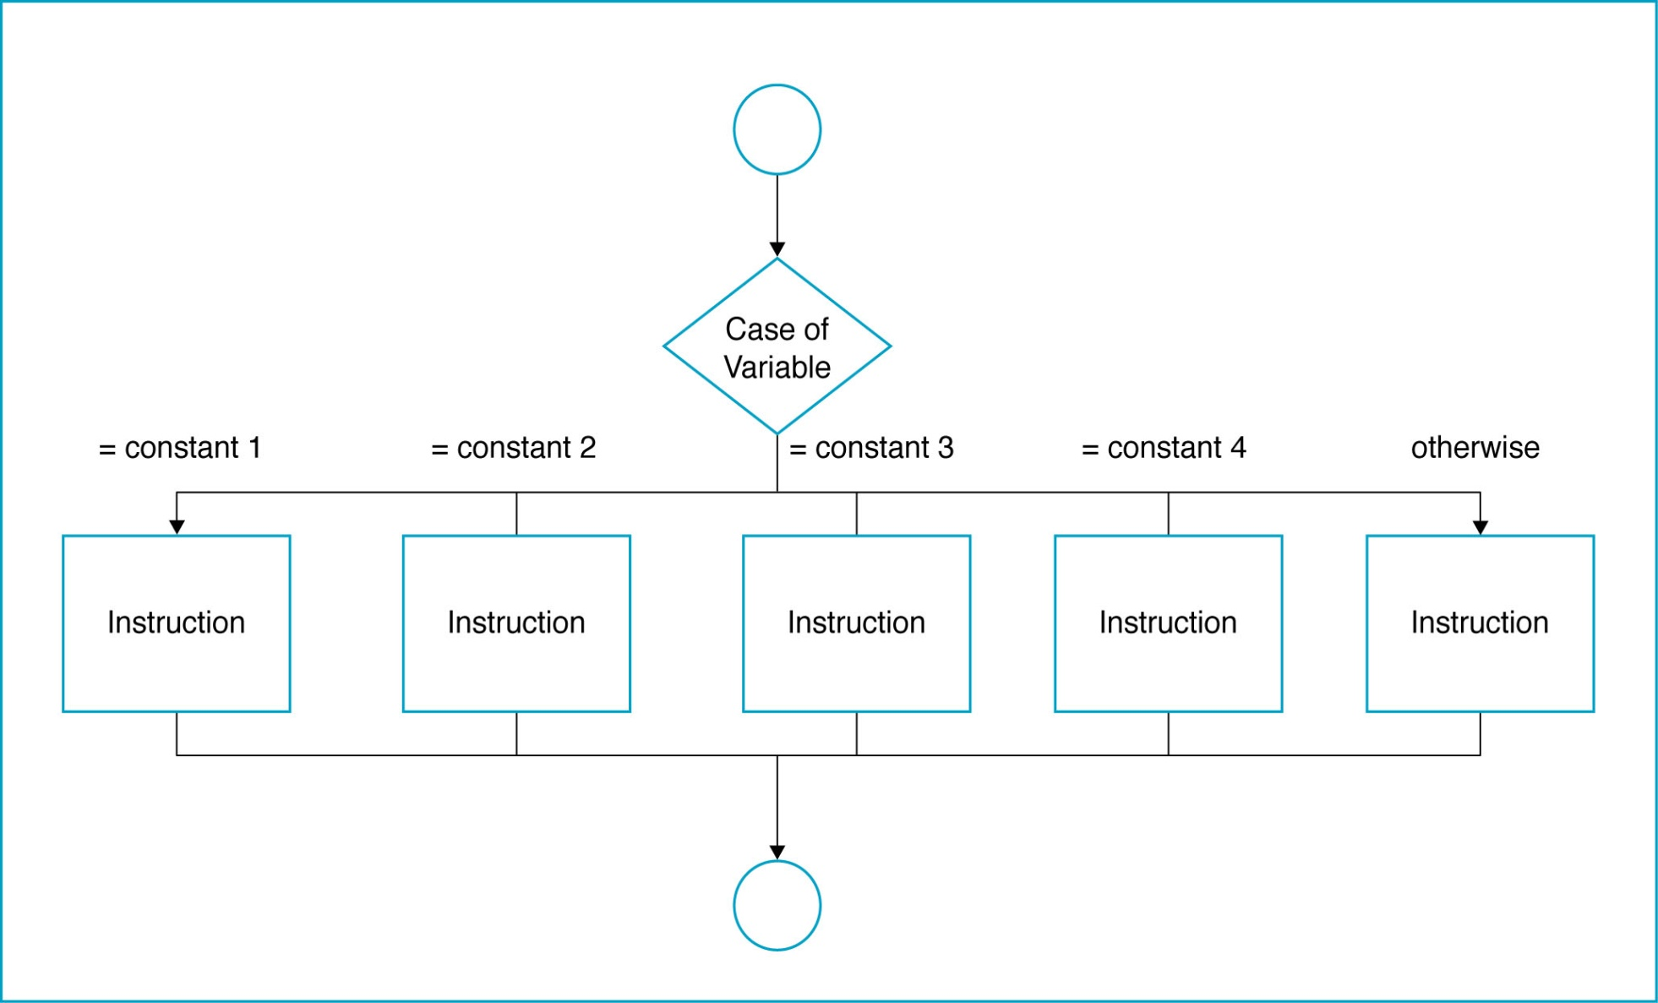
Case Logic Structure

Slide 59
switch Statement Rules
The switch-expression must yield a value of char, byte, short, int or String type and must always be enclosed in parentheses.
switch (switch-expression) {
case value1: statement(s)1;
break;
case value2: statement(s)2;
break;
…
case valueN: statement(s)N;
break;
default: statement(s)-for-default;
}
The value1, ..., and valueN must have the same data type as the value of the switch-expression. The resulting statements in the case statement are executed when the value in the case statement matches the value of the switch-expression. Note that value1, ..., and valueN are constant expressions, meaning that they cannot contain variables in the expression, such as 1 + x.

Slide 60
switch Statement Rules
The keyword break is optional, but it should be used at the end of each case in order to terminate the remainder of the switch statement. If the break statement is not present, the next case statement will be executed.
switch (switch-expression) {
case value1: statement(s)1;
break;
case value2: statement(s)2;
break;
…
case valueN: statement(s)N;
break;
default: statement(s)-for-default;
}
The default case, which is optional, can be used to perform actions when none of the specified cases matches the switch-expression.
The case statements are executed in sequential order, but the order of the cases (including the default case) does not matter. However, it is good programming style to follow the logical sequence of the cases and place the default case at the end.

Slide 61
Example
Item code | Price (RM)
1 | 4.96
2 | 3.25
3 | 10.50
4 | 8.40
5 | 6.00
switch(itemcode){
case 1: price = 4.96;
break;
case 2: price = 3.25;
break;
case 3: price = 10.50;
break;
case 4: price = 8.40;
break;
case 5: price = 6.00;
break;
}

Slide 62
Example
Example:
Item code | Price (RM)
1 | 4.96
2 | 3.25
3 | 10.50
4 | 8.40
5 | 6.00
Case of itemcode
= 1
= 2
= 3
= 4
= 5
price = 4.96
price = 3.25
price = 10.50
price = 8.40
price = 6.00

Slide 63
Example
Example:
Grade | Point
A | 4.0
B | 3.0
C | 2.0
D | 1.0
F | 0.0
Case of Grade
= ‘A’
= ‘B’
= ‘C’
= ‘D’
= ‘F’
point = 4.0
point = 3.0
point = 2.0
point = 1.0
point = 0.0

Slide 64
Example
Grade | Point
A | 4.0
B | 3.0
C | 2.0
D | 1.0
F | 0.0
switch(grade){
case ‘A’: point = 4.0;
break;
case ‘B’: point = 3.0;
break;
case ‘C’: point = 2.0;
break;
case ‘D’: point = 1.0;
break;
case ‘F’: point = 0.0;
break;
}

Slide 65
Example
import java.io.IOException;
import java.util.Scanner;
public class Grade_Point{
public static void main(String[] args) throws IOException {
Scanner input = new Scanner(System.in);
System.out.print("Enter grade: ");
char grade = (char) System.in.read();
double point;
switch (grade) {
case 'A' : point = 4.0;
break;
case 'B' : point = 3.0;
break;
case 'C' : point = 2.0;
break;
case 'D' : point = 1.0;
break;
case ‘F' : point = 0.0;
break;
default : System.out.println(“Grade unknown");
}
System.out.print("Point : " + point);
}
}
What happen if the user entered ‘a’ instead of ‘A’?

Slide 66
Example
We can include both uppercase and lowercase letters in the case.
Equivalent to
if (grade==‘A’) || (grade==‘a’)
switch(grade){
case ‘A’: case ‘a’: point = 4.0;
break;
case ‘B’: case ‘b’: point = 3.0;
break;
case ‘C’: case ‘c’: point = 2.0;
break;
case ‘D’: case ‘d’: point = 1.0;
break;
case ‘F’: case ‘f’: point = 0.0;
break;
default : System.out.println(“Grade unknown");
}

Slide 67
Exercise
Code | Specialization
480 | Multimedia
481 | Computer System
482 | Software Engineering
483 | Computer Network
Write a switch statement to print the specialization based on the code entered.

Slide 68
Trace switch statement
animation
Suppose ch is 'a':
switch (ch) {
case 'a': System.out.println(ch);
case 'b': System.out.println(ch);
case 'c': System.out.println(ch);
}

Slide 69
Trace switch statement
animation
ch is 'a':
switch (ch) {
case 'a': System.out.println(ch);
case 'b': System.out.println(ch);
case 'c': System.out.println(ch);
}

Slide 70
Trace switch statement
animation
Execute this line
switch (ch) {
case 'a': System.out.println(ch);
case 'b': System.out.println(ch);
case 'c': System.out.println(ch);
}

Slide 71
Trace switch statement
animation
Execute this line
switch (ch) {
case 'a': System.out.println(ch);
case 'b': System.out.println(ch);
case 'c': System.out.println(ch);
}

Slide 72
Trace switch statement
animation
Execute this line
switch (ch) {
case 'a': System.out.println(ch);
case 'b': System.out.println(ch);
case 'c': System.out.println(ch);
}

Slide 73
Trace switch statement
animation
Execute next statement
switch (ch) {
case 'a': System.out.println(ch);
case 'b': System.out.println(ch);
case 'c': System.out.println(ch);
}
Next statement;

Slide 74
Trace switch statement
animation
Suppose ch is 'a':
switch (ch) {
case 'a': System.out.println(ch);
break;
case 'b': System.out.println(ch);
break;
case 'c': System.out.println(ch);
}

Slide 75
Trace switch statement
animation
ch is 'a':
switch (ch) {
case 'a': System.out.println(ch);
break;
case 'b': System.out.println(ch);
break;
case 'c': System.out.println(ch);
}

Slide 76
Trace switch statement
animation
Execute this line
switch (ch) {
case 'a': System.out.println(ch);
break;
case 'b': System.out.println(ch);
break;
case 'c': System.out.println(ch);
}

Slide 77
Trace switch statement
animation
Execute this line
switch (ch) {
case 'a': System.out.println(ch);
break;
case 'b': System.out.println(ch);
break;
case 'c': System.out.println(ch);
}

Slide 78
Trace switch statement
animation
Execute next statement
switch (ch) {
case 'a': System.out.println(ch);
break;
case 'b': System.out.println(ch);
break;
case 'c': System.out.println(ch);
}
Next statement;

Slide 79
Exercise
From the previous exercise…
A mail-order house sells five products whose retail prices are as follows: Product 1 = RM2.98; product 2 = RM4.50; product 3 = RM9.98; product 4 = 4.49 and product 5 = RM6.87.
Draw a flowchart and write a program that reads:
product number
quantity sold
Calculate the total price for the products sold.
Display the output.
Use switch statements / convert the multi-way selection to switch statements

Slide 80
Example: Medical Plans
A company has four different medical plans. The programmer has given each plan a code corresponding to the beginning initial of the company: Plan 1 = F, Plan 2 = B, Plan 3 = K, Plan 4 = E.
The company pays for all of Plan 1. The individual has to pay for part of the others. The payroll deduction for Plan 2 = 4.65, for Plan 3 = 7.85, and for Plan 4 = 5.50. Any other codes are considered in error.
Write the algorithm and draw the flowchart for a module to determine the payroll deduction.

Slide 81
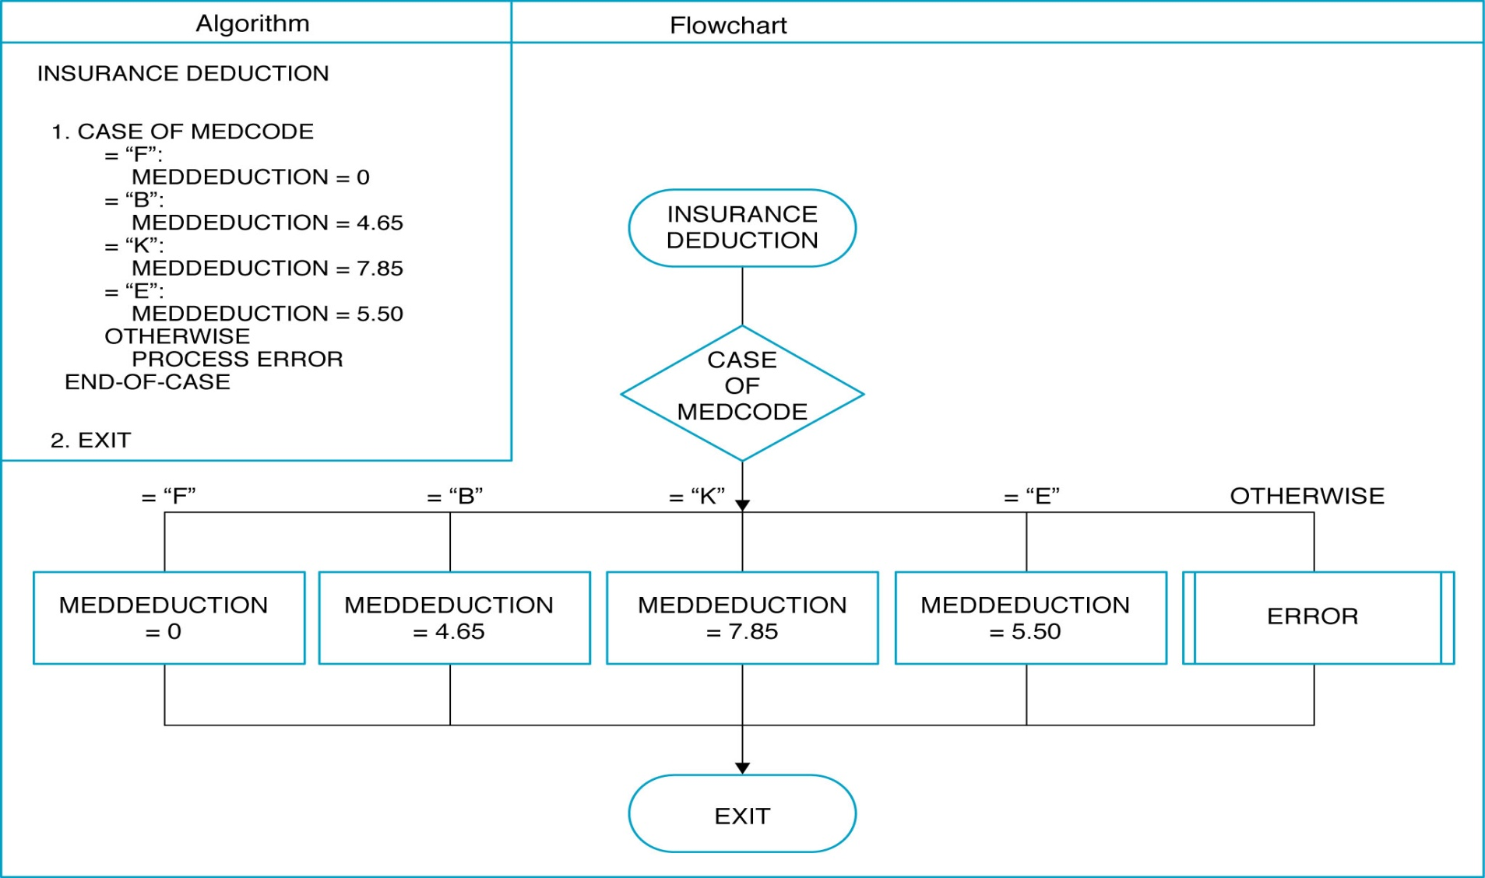
Example: Medical Plans

Slide 82
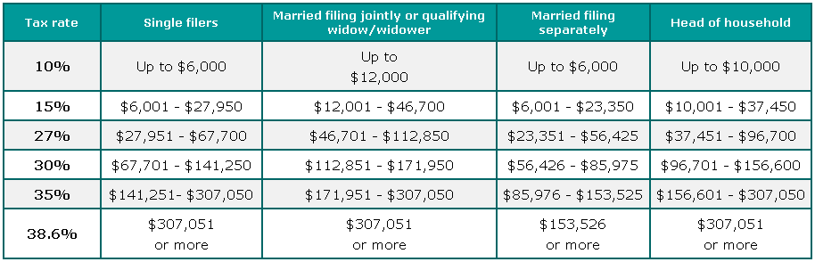
Example: Computing Taxes
The US federal personal income tax is calculated based on the filing status and taxable income. There are four filing statuses: single filers, married filing jointly, married filing separately, and head of household. The tax rates for 2002 are shown in the table below.

Slide 83
Example: Computing Taxes, cont.
if (status == 0) {
// Compute tax for single filers
}
else if (status == 1) {
// Compute tax for married file jointly
}
else if (status == 2) {
// Compute tax for married file separately
}
else if (status == 3) {
// Compute tax for head of household
}
else {
// Display wrong status
}

Slide 84
switch Statements
int status;
…
switch (status) {
case 0: // compute taxes for single filers;
…
break;
case 1: // compute taxes for married file jointly;
break;
case 2: // compute taxes for married file separately;
break;
case 3: // compute taxes for head of household;
break;
default: System.out.println("Errors: invalid status");
System.exit(0);
}

Slide 85
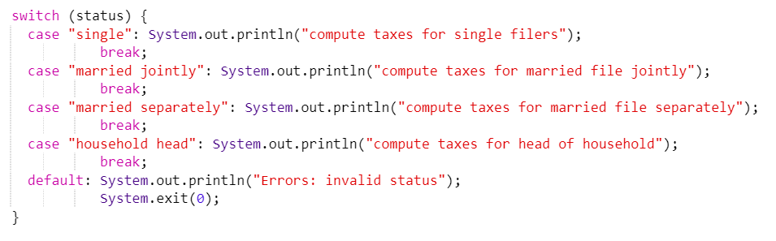
switch Statements
import java.lang.String;
…
String status;

Slide 86
Exercise
What is y after the following switch statement is executed? Rewrite the code
using an if-else statement.
x = 3; y = 3;
switch (x + 3) {
case 6: y = 1;
default: y += 1;
}

Slide 87
Exercise
What is x after the following if-else statement is executed? Use a switch statement
to rewrite it and draw the flowchart for the new switch statement.
int x = 1, a = 3;
if (a == 1)
x += 5;
else if (a == 2)
x += 10;
else if (a == 3)
x += 16;
else if (a == 4)
x += 34;

Slide 88
Exercise
Write a switch statement that displays Sunday, Monday, Tuesday, Wednesday,
Thursday, Friday, Saturday, if day is 0, 1, 2, 3, 4, 5, 6, respectively.

